Slide 1
Software Project
Reversi Game

Slide 2
Game Overview
a strategy board game for two players, played on an 8×8 uncheckered board.
The object of the game is to have the majority of discs.

Slide 3


How you can win ?

Slide 4
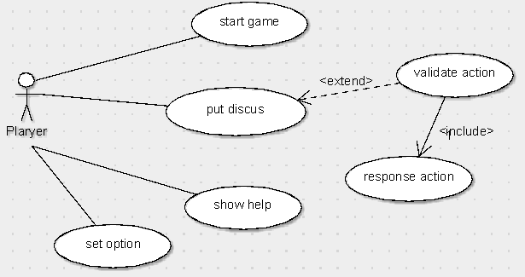
Design: 1. Usecase

Slide 5
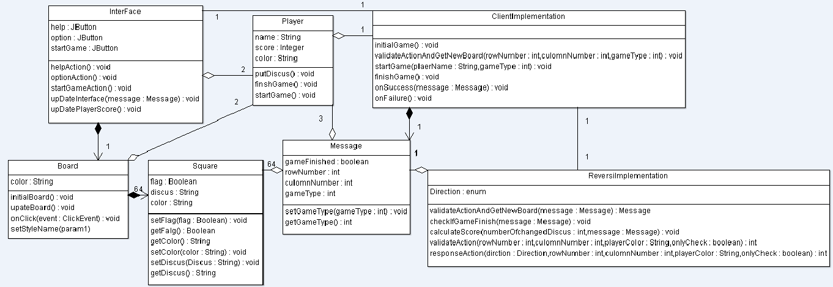
Design: 2. class Diagram

Slide 6
Lessons:
We learnt GWT technology
Importance of team work
First thing is Design then code

Slide 7
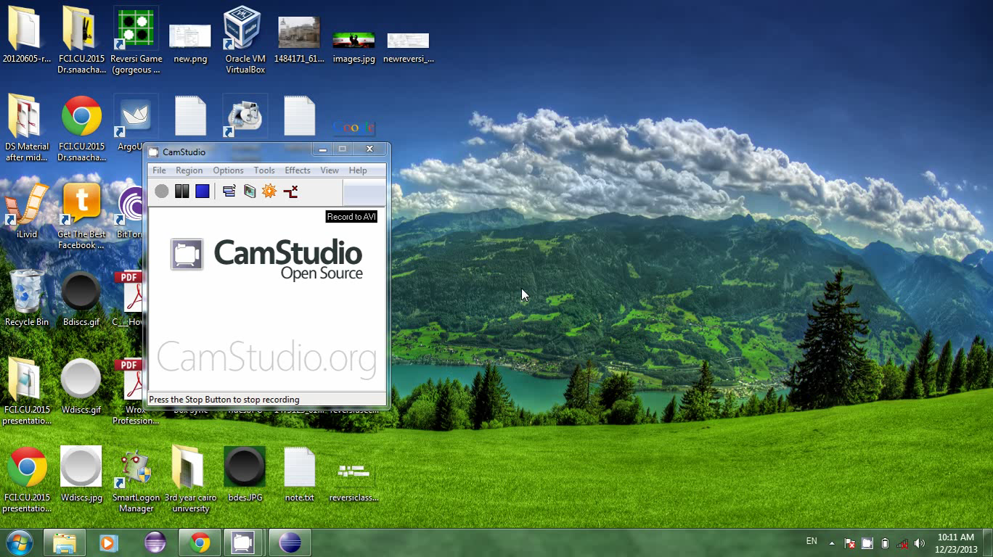
Demo

